Slide 1
Power BI Adoption Framework
Empower every decision maker
What to Secure

Slide 2
Why Security needs to be reviewed
Data Location
On-Premises
Cloud
Data Access
Sharing
Row-Level Security
Public

Slide 3



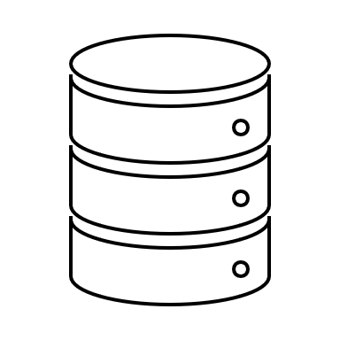

Considerations
Data Classification
Data source access
Security trimming
Data Preparation
Excel / Flat file
Data Sources

Slide 4



Where is your data?
Cloud
On-premises
How do you refresh?
Personal gateway
On-premises data gateway
How do you connect?
Import data
Direct / Live query
Connecting data to Power BI

Slide 5

Cloud Models
Dataset metadata and data stored in Power BI
External Models
Dataset metadata stored in Power BI
Data stored externally
How Power BI views your data model

Slide 6
Thank you

